Slide 1



THE
COMPANY
PROFILE
Group B | Abdulaziz A., Gauchet Van A., Nabil M.,
Ckalib N., ​ Addison P., Michael W., Sarang Z.
Risk and Fraud Analytics | PROFESSOR: mANOEL FERNANDO GADI ALONSO
Notes:
Hi, my name is Ckalib Nelson and I am a member of Group B, which includes Abdulaziz, Gauchet, Nabil, Addison, Michael, and Sarang. We are excited to provide you a company profile of Comunitae.

Slide 2

COMPANY
INTRODUCTIONS
Comunitae is the pioneer peer-to-peer lending platform in Spain to offer individuals a new way to save more profitably than traditional financial products.
COMPANY REACH
Since its opening in 2009, they have lent around 15 million euros, with delinquency levels below that of traditional banks.
COMPANY REPUTATION
The average return was 8.17% for investors. And at that time, they established themselves as the most important crowdlending platform in Spain.
Notes:
Comunitae is the leading peer-to-peer lending platform in Spain. Comunitae has lent more than 10 million Euros in the last 12 years with much lower delinquency levels than traditional banks. Even more impressively, the average return for investors is roughly 8% making them an intriguing crowdlending platform in the country.

Slide 3

SOURCES OF INCOME
1
Opening commission, paid by the borrower, 3% of the loan amount
2
Non-payment commission, paid by the borrower, 8% of the unpaid installment
3
Commission for return costs, paid by the borrower, ranges between 5 euros for amounts between € 0 and € 49 and € 60 for amounts of € 500 or more.
4
Commission for deposit with credit card, paid by the investor, maximum of 2%.
5
Commission for special operations, a commission of € 30 will be applied for each request for additional services to those agreed in the document.
6
Commission for direct debit expenses, € 1 for each direct debit receipt.
Notes:
Comunitae has many sources of income. Among those sources of income are commissions on the loan amount, return costs, and special operations, which are paid by the borrower.

Slide 4

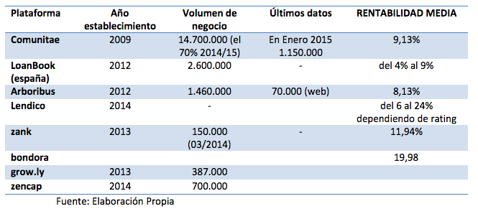
COMPANY RANKING
Comunitae is leading the peer-to-peer business in Spain. Only looking at the third column, we can observe that Comunitae has more than 5 times the volume of business than the second competitor, LoanBook, and that the average profitability rate is higher as well.
Notes:
Given Comunitae’s impressive reputation throughout Spain, it should come as no surprise that Comunitae has more than five times the volume of business than their fiercest competitor, LoanBook. Similarly, relative to their competitors, the average profitability rate is higher.

Slide 5

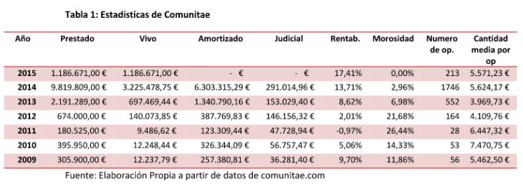
INGREDIENTS THAT LED TO SUCCESS OF COMPANY
Comunitae focus on profitability rather than on carrying out a large number of operations. Rejection rate is around 90% and average interest on loans is at levels between 10 and 11%. The high rejection rate lays the foundations for people to trust the platform
Currently, the bank delinquency stands at 12.7%, however at Comunitae, this indicator is below 3%. By having such low delinquency, the percentage of profitability increases, standing at 13.71% for 2014. Comunitae makes its own risk assessment, with a non-negotiable pre-tax fixed interest rate (APR)
Just for reference, their average operation is € 6,000. Below we can observe the growth of Comunitae from 2009 till 2015:
Notes:
The reasons why Comunitae is successful are that they focus their attention only on a select group of individuals, meaning their rejection rate is quite high. Additionally, Comunitate has a very low delinquency rate, allowing them to make more of their expected amount of revenue.

Slide 6

ABOUT
TECH STACK
Comunitae focused on unique technology combinations in their business that made their work very attractive, fast, and responsive. As example they have mixed multiple cloud-based technology for different purposes as the following:
Development Stack
HTML5
Boostrap
Highcharts
Marketing & Data Analytics
AD Roll
Google Double Click
Google Tag Manager
G Suite
DevOps & IT Stack
AWS Elastic
Amazon EC2
Amazon Route 53
Comodo SSL
Zendesk

Slide 7


ABOUT INVESTORS
There are 3 main investors who supported Comunitae in its journey:
CABIEDES PARTNERS
ABRA INVEST
FRANCOIS DERBAIX
Spanish venture capital firm that provides seed funding and early-stage and later-stage investment services.
Provides alternative financing for small and medium enterprises.
Co-founder and co-CEO of Indexa Capital and co-founder and Director of Bewater Funds.

Slide 8

COMPANY
FUNDING
Comunitae has raised a total of €3.5M in funding over 3 rounds. Their latest funding was raised on Jan 18, 2012 from a Series B round.
Announced Date | Transaction Name | Number of Investors | Money Raised
Jan-12 | Series B - Comunitae | 2 | €1M
Jul-09 | Series A - Comunitae | — | €2.5M
Jan-08 | Seed Round - Comunitae | 1 | —

Slide 9

ABOUT
COMPETITORS
As depicted earlier, Comunitae does not have a competitor from their same level in Spain, however in Europe there are a few companies that are doing quite well in the same field. The most successful companies are located in Eastern Europe. Below is the list of the main European competitors:
BONDORA
MINTOS
TWINO
PEER BERRY
DO FINANCE

Slide 10
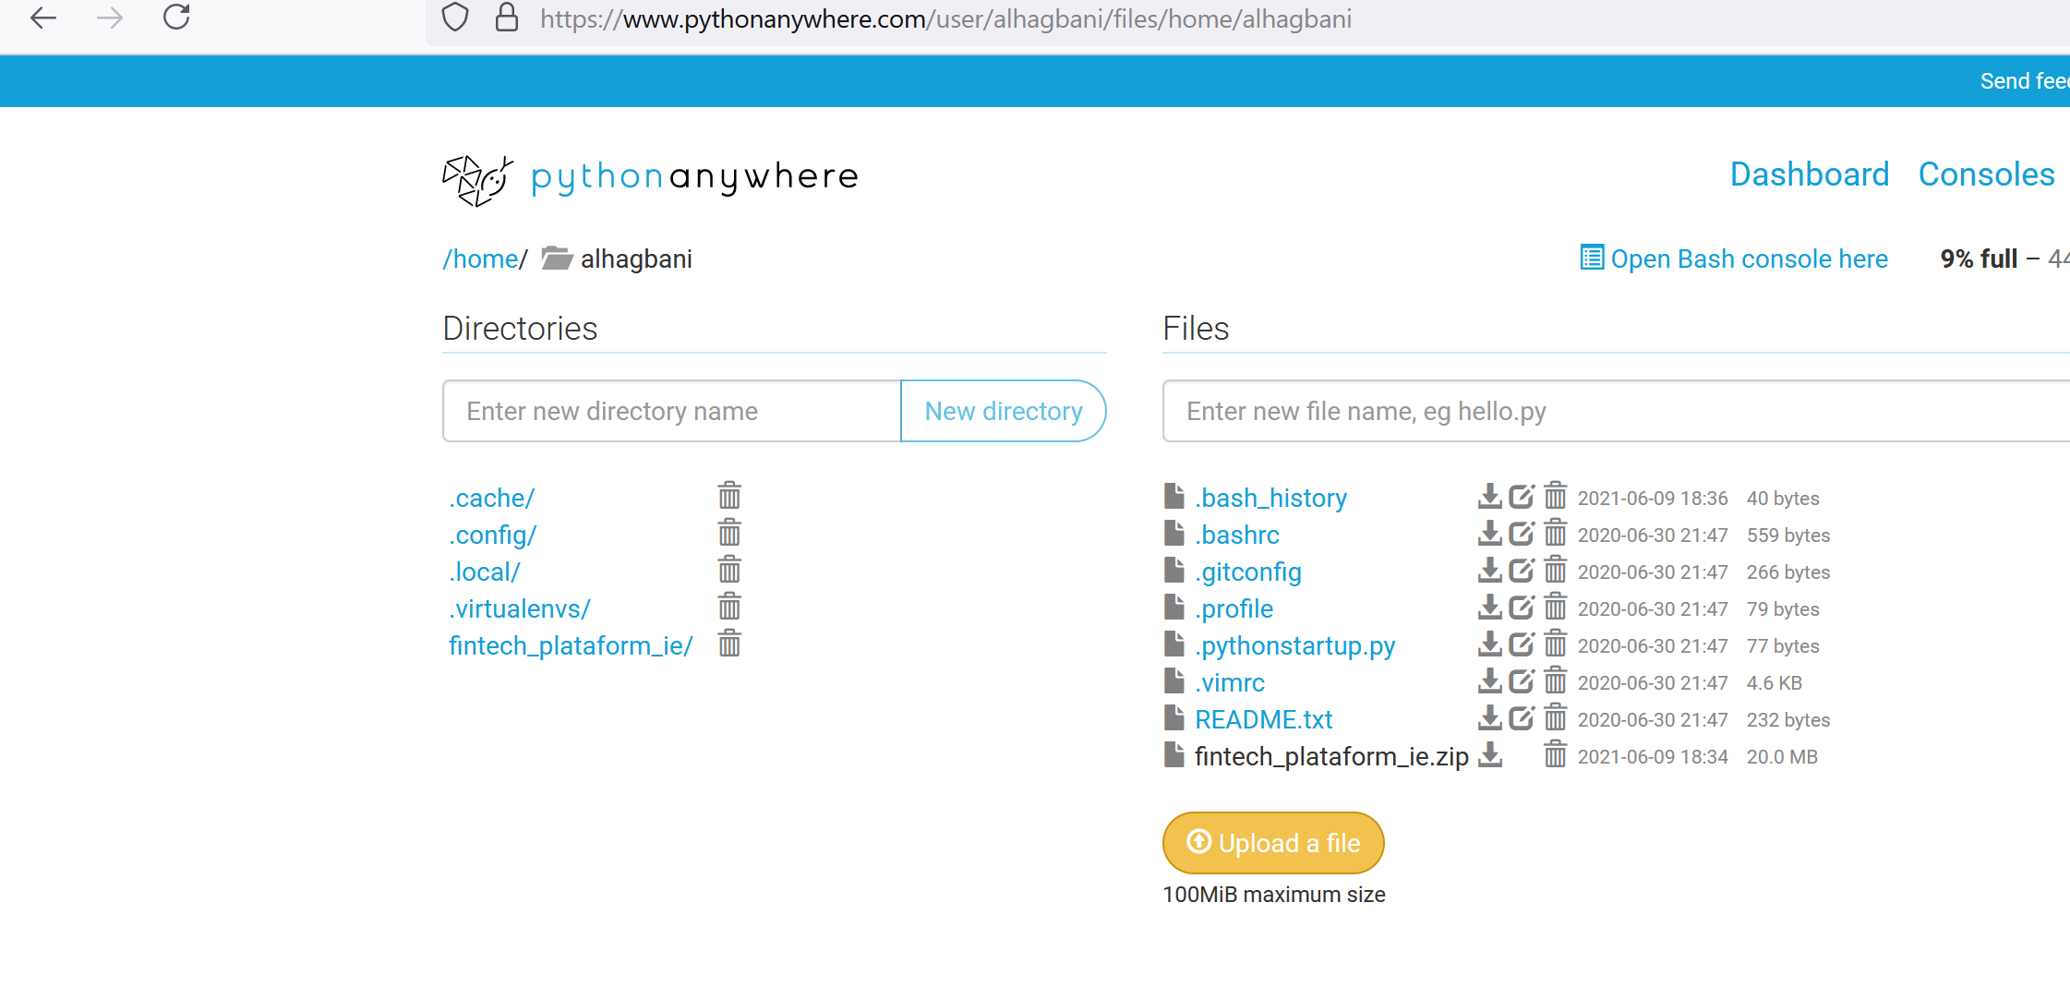
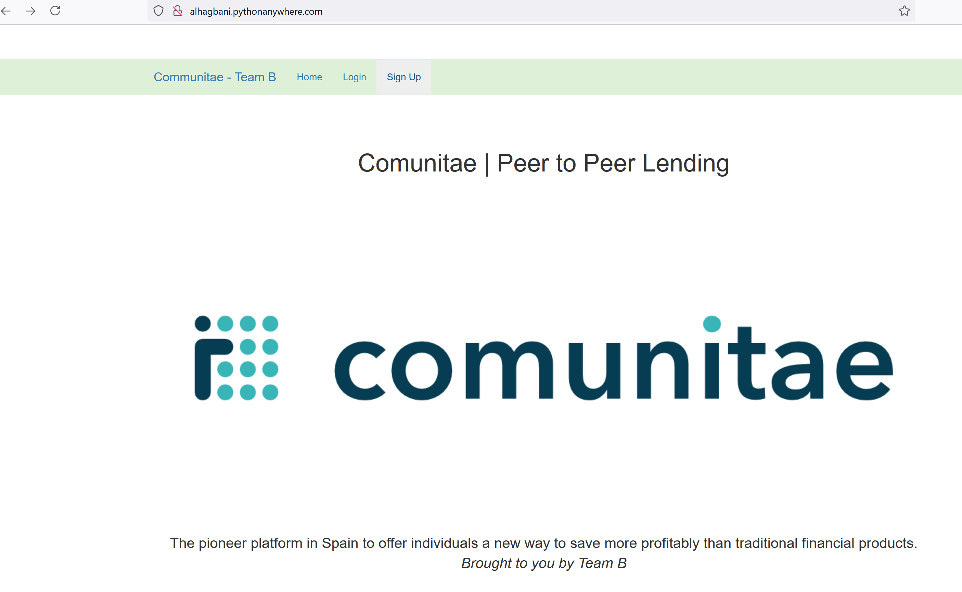

USER INTERFACE
Hosting platform
Website Front-page

Slide 11
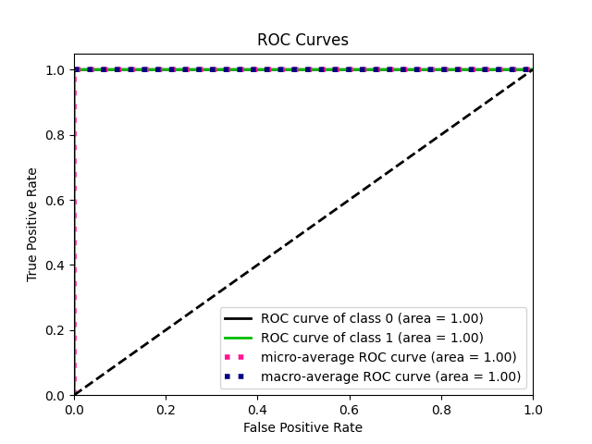
ROC
Our model is trained on the whole data set as a result we can see the performance near perfect. Therefore in this case we will be using standalone model. If we wish to optimise our models down the line we could consider other strategies such as :
Combined modelling – Predictions are result integration of different models.
Embedded model – Taking output of other results in as feature to improve our performance

Slide 12

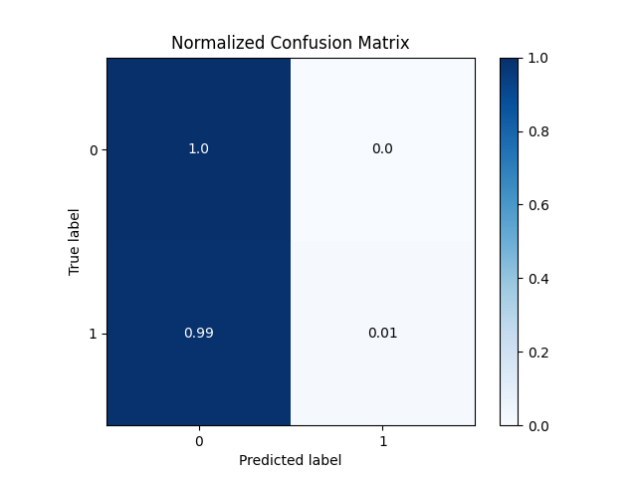
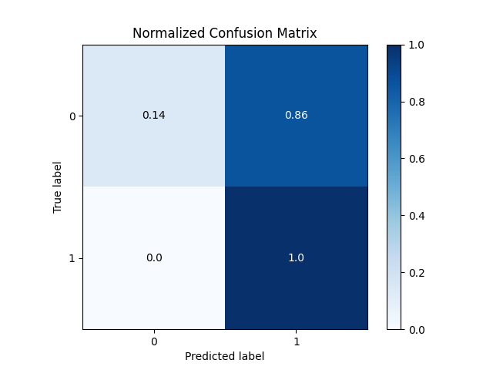
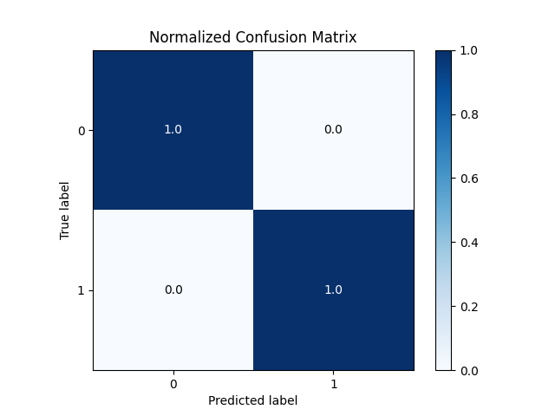
CUT OFF POINT
Cut off = 0.9
Cut off = 0.0000001
CUT OFF POINT
High cut off points means we are adding risk by having high probability tolerance. It is apparent here high cut off point increases the False negative significantly and as expected we would capture all True Positive. In this case we would could add loses down the line with defaults.
Really low cut off point has the inverse effect of what we saw in high cut off point. Here we are very strict and eliminate all False Negative cases but missing out on big chunk of true positive cases which could mean we are missing out revenue stream.
Cut off = 0.5
Ideally we would want mixture of what we saw above. We want to capture all the true positive and true negative cases. Which means we are accepting all the good candidates and rejecting the ones with probability of default. Cut off point of 0.5 appears to achieve this objective.

Slide 13
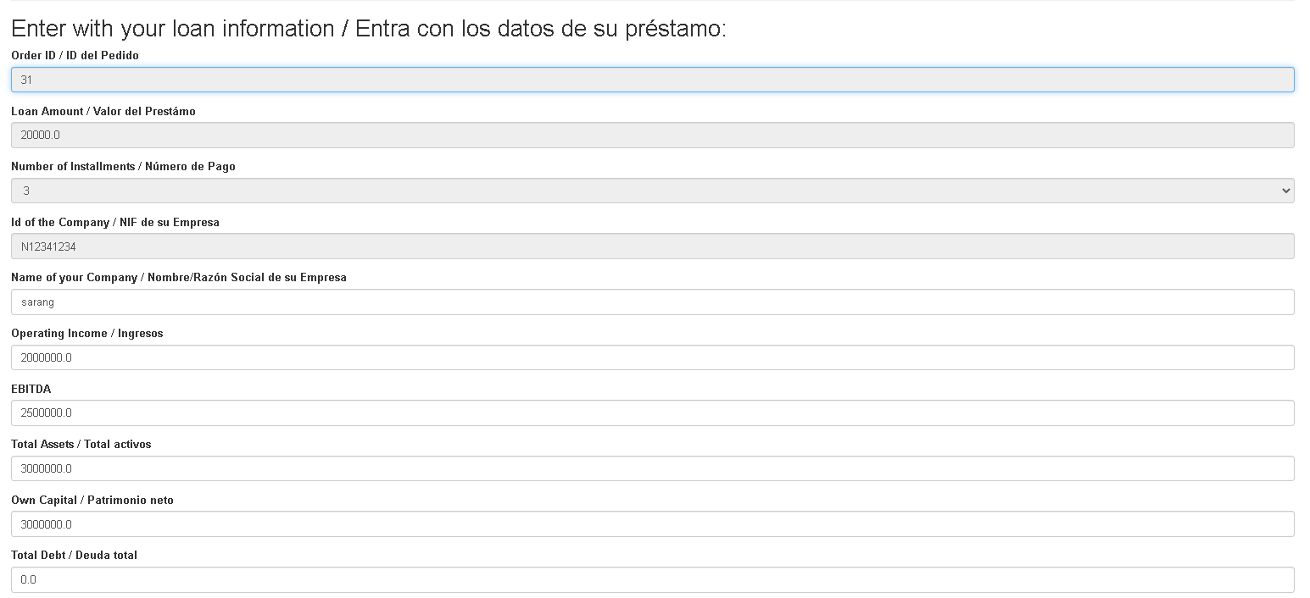
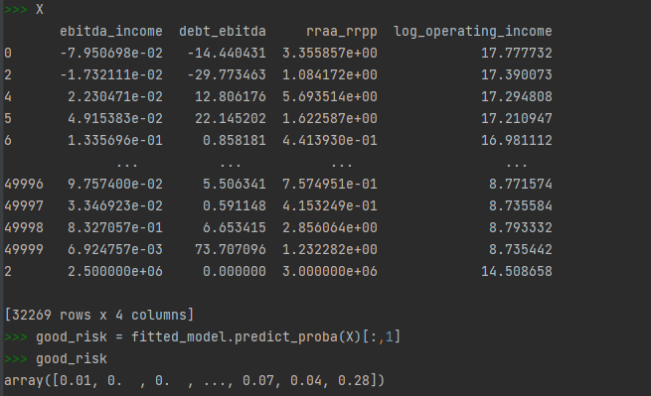
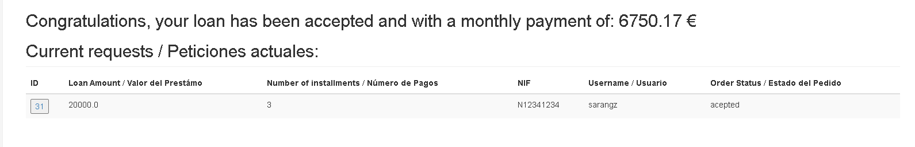
EXAMPLE

